Slide 1
Simple online and offline resources for making learning more interactive
Software and Data Carpentry Instructor & Helper Retreat
November 14, 2015
Lex Nederbragt
Centre for Evolutionary and Ecological Synthesis
University of Oslo
http://pad.software-carpentry.org/swc-instructor-retreat-2015-3PM-UTC

Slide 2
Outline
Who am I
Teaching genome assembly
Let’s assemble a genome together!
Multiple choice quizzes
Q&A, discussion

Slide 3




Who am I
@lexnederbragt
flxlexblog.wordpress.com

Slide 4
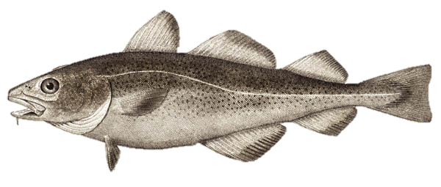
Atlantic cod genome

Slide 5

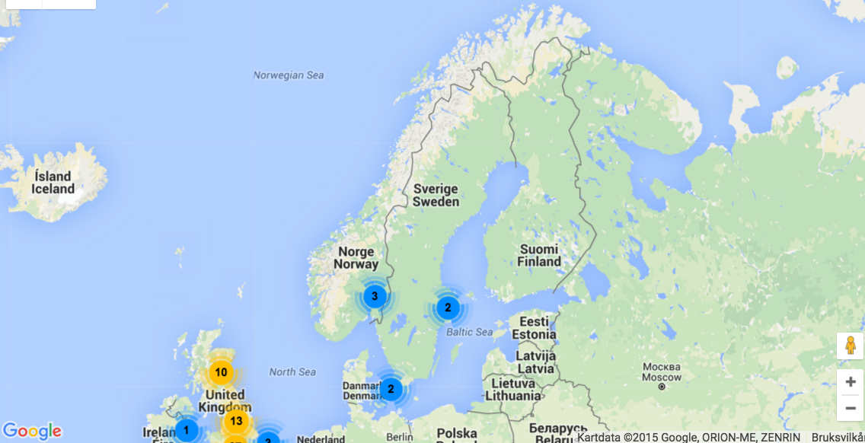
Instructor since 2013

Slide 6
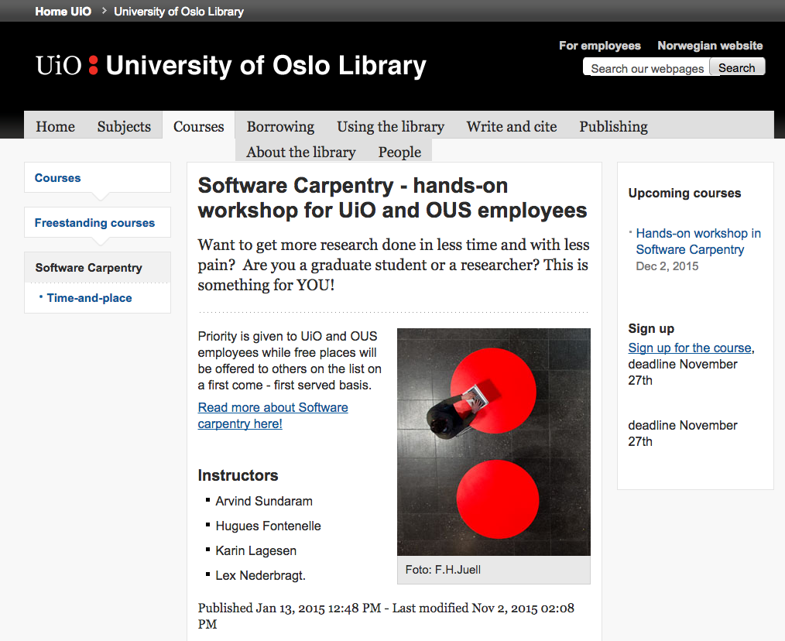

Slide 7
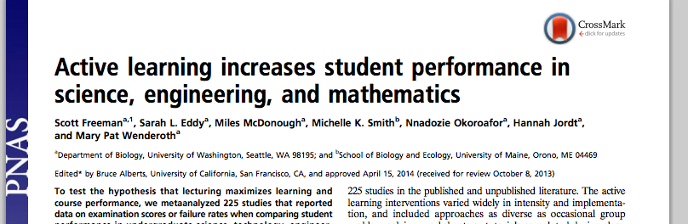
(Inter)active learning
doi: 10.1073/pnas.1319030111

Slide 8
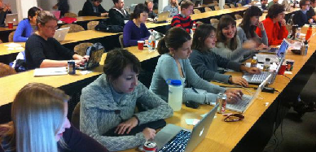
(Inter)active learning
Software Carpentry = active learning
https://software-carpentry.org/pages/testimonials.html

Slide 9
This session
Examples of other approaches to active learning
Online
Offline

Slide 10
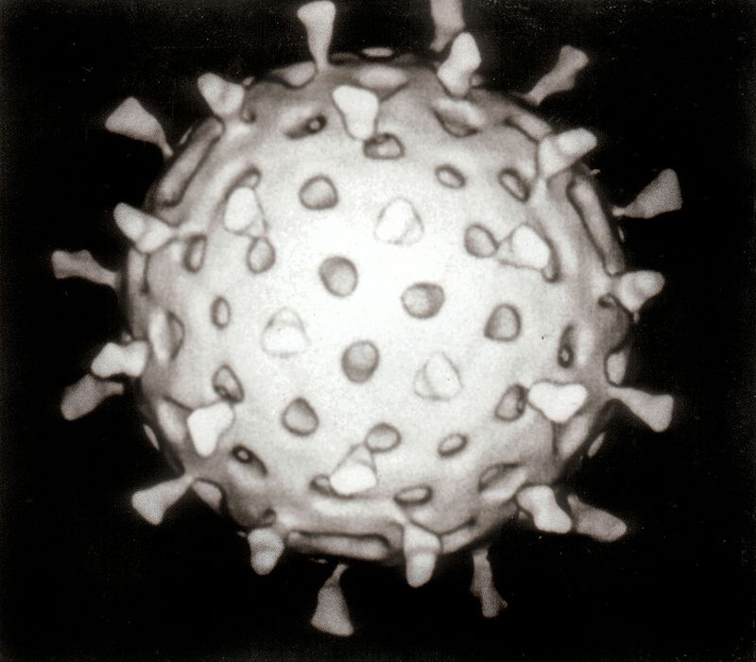


Genomes
Rotavirus
18,555 characters
Escherichia coli bacterium
4 to 5 million characters
Homo sapiens
3.2 billion characters
‘Characters’: A, C, G and T
Graham Beards -CC BY 3.0 via Commons - https://commons.wikimedia.org/wiki/File:Rotavirus_Reconstruction.jpg#/media/File:Rotavirus_Reconstruction.jpg & Rocky Mountain Laboratories, NIAID, NIH Public Domain via Commons - https://commons.wikimedia.org/wiki/File:EscherichiaColi_NIAID.jpg#/media/File:EscherichiaColi_NIAID.jpg

Slide 11
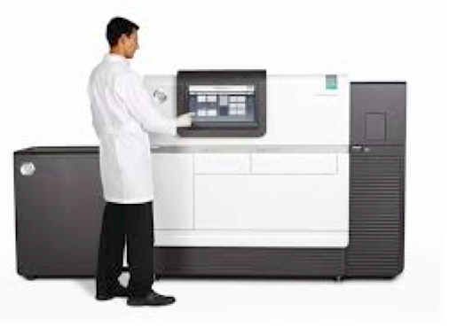
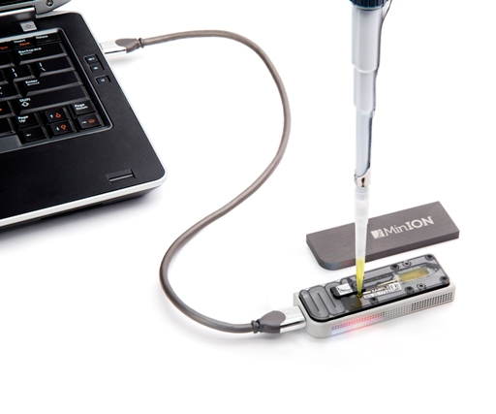
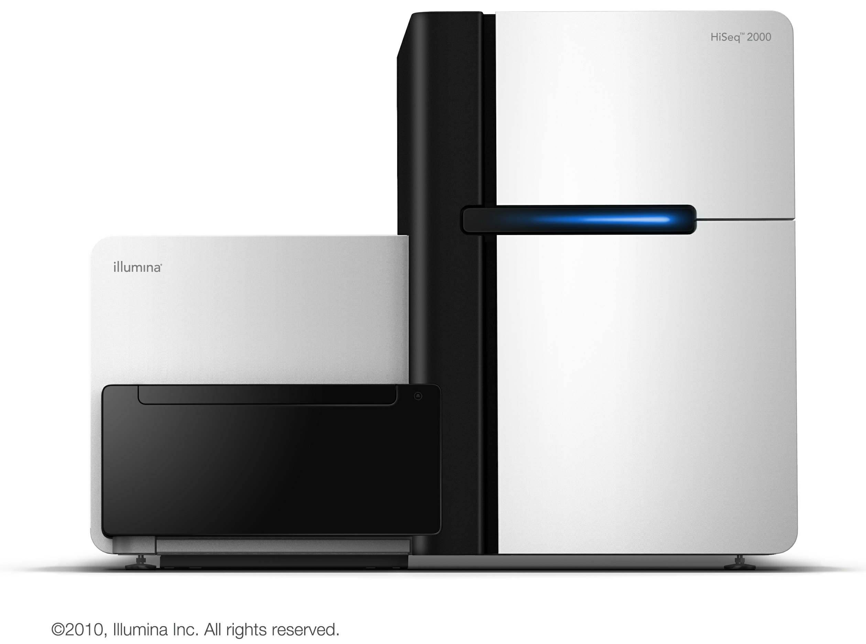
Sequencing
HiSeq from Illumina
RS II from
Pacific Biosciences
MinION from
Oxford Nanopore
125 to 300 characters
Billions of them
Up to 75,000 characters
Around a million of them
Up to 100,000 characters
Half a million of them

Slide 12
What is this ‘assembly’ thing?
ACGCGATTCAGGTTACCA
CAGGTTACCACGCGTACG
GCGATTCAGGTTACCACG
ACCACGCGTACGCGATTA
GATTCAGGTTACCACGCG
TTCAGGTTACCACGCGTA
GGTTACCACGCGTACGCG
CACGCGTACGCGATTACA
TTACCACGCGTACGCGAT
CGCGTACGCGATTACACA
TACGCGATTACACAGATTAG
CGTACGCGATTACACAGATT

Slide 13
What is this ‘assembly’ thing?
ACGCGATTCAGGTTACCA
GCGATTCAGGTTACCACG
GATTCAGGTTACCACGCG
TTCAGGTTACCACGCGTA
CAGGTTACCACGCGTACG
GGTTACCACGCGTACGCG
TTACCACGCGTACGCGAT
ACCACGCGTACGCGATTA
CACGCGTACGCGATTACA
CGCGTACGCGATTACACA
CGTACGCGATTACACAGATT
TACGCGATTACACAGATTAG
ACGCGATTCAGGTTACCACGCGTACGCGATTACACAGATTAG

Slide 14
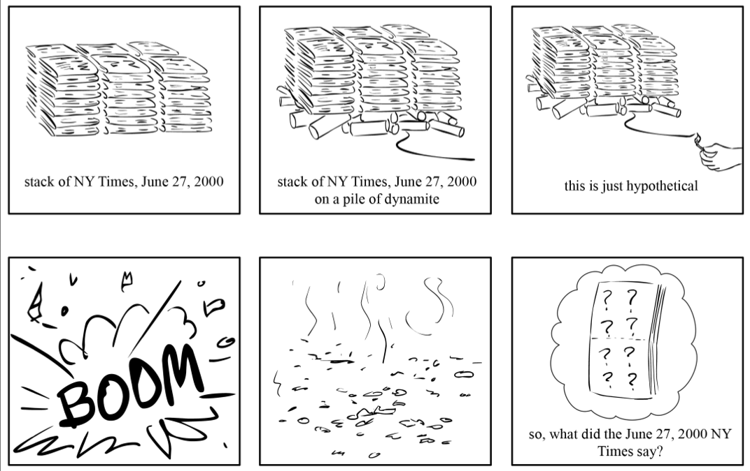
An analogy
Compeau & Pevzner 2010 http://cseweb.ucsd.edu

Slide 15
An analogy
"It was the best of times, it was the worst of times, it was the age of wisdom, it was the age of foolishness, it was the epoch of belief, it was the epoch of incredulity,…
Charles Dickens, “A Tale of Two Cities”
Now we shred a bunch of copies
Slides courtesy of/after Mike Schatz, Cold Spring Harbor Laboratory http://schatzlab.cshl.edu/teaching/2014/
Quote: https://en.wikisource.org/wiki/A_Tale_of_Two_Cities/Book_the_First/Chapter_I

Slide 16
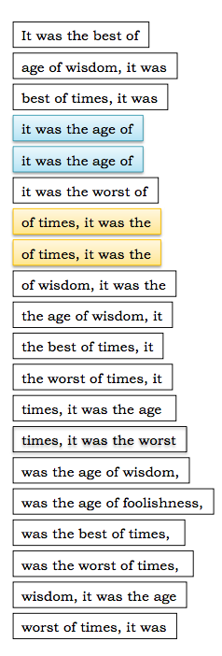
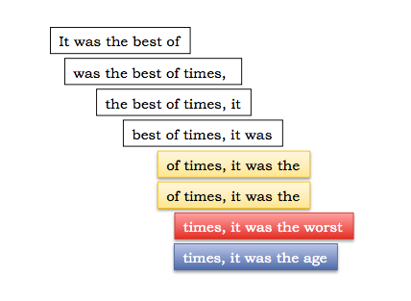
An analogy
"It was the best of times, it was the worst of times, it was the age of wisdom, it was the age of foolishness, it was the epoch of belief, it was the epoch of incredulity,…
Slides courtesy of/after Mike Schatz, Cold Spring Harbor Laboratory http://schatzlab.cshl.edu/teaching/2014/

Slide 17
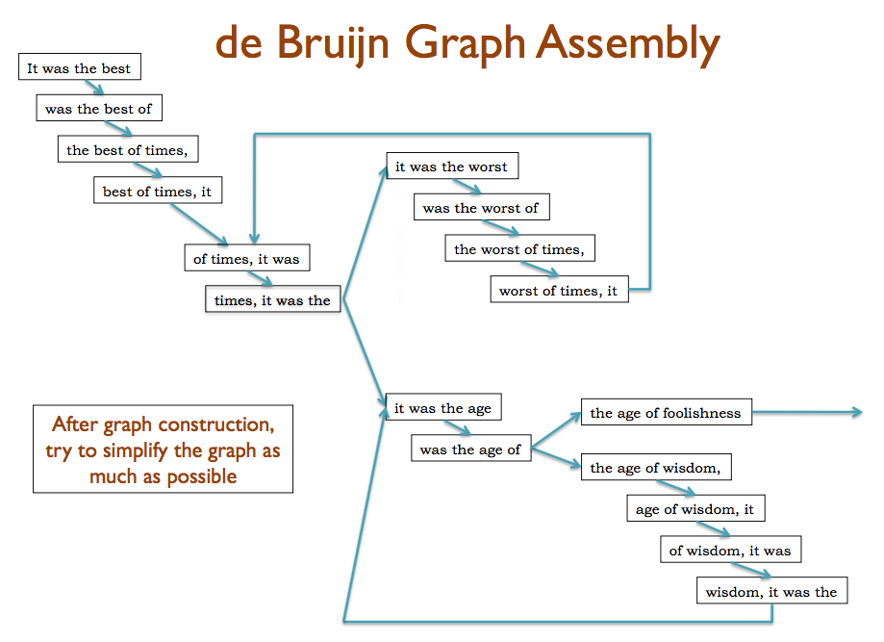
Slides courtesy of/after Mike Schatz, Cold Spring Harbor Laboratory http://schatzlab.cshl.edu/teaching/2014/

Slide 18
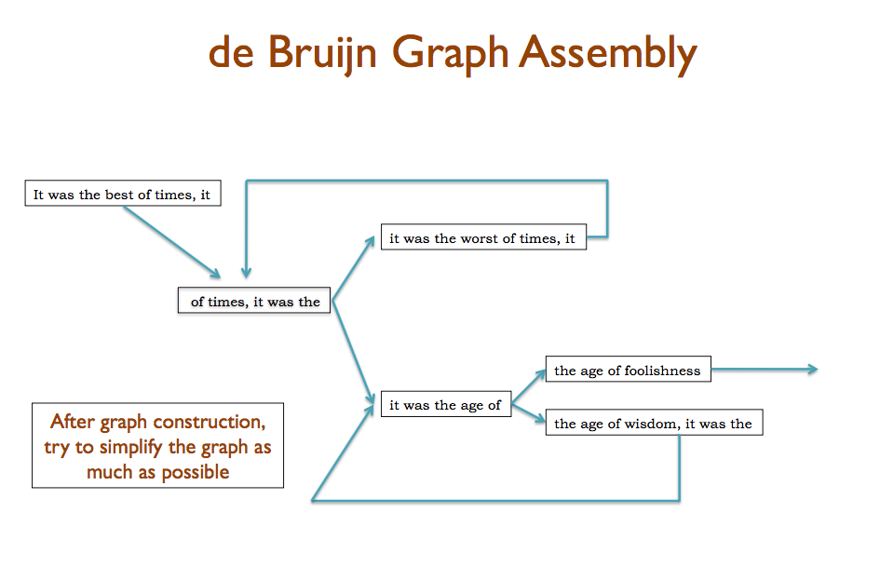
Slides courtesy of/after Mike Schatz, Cold Spring Harbor Laboratory http://schatzlab.cshl.edu/teaching/2014/

Slide 19
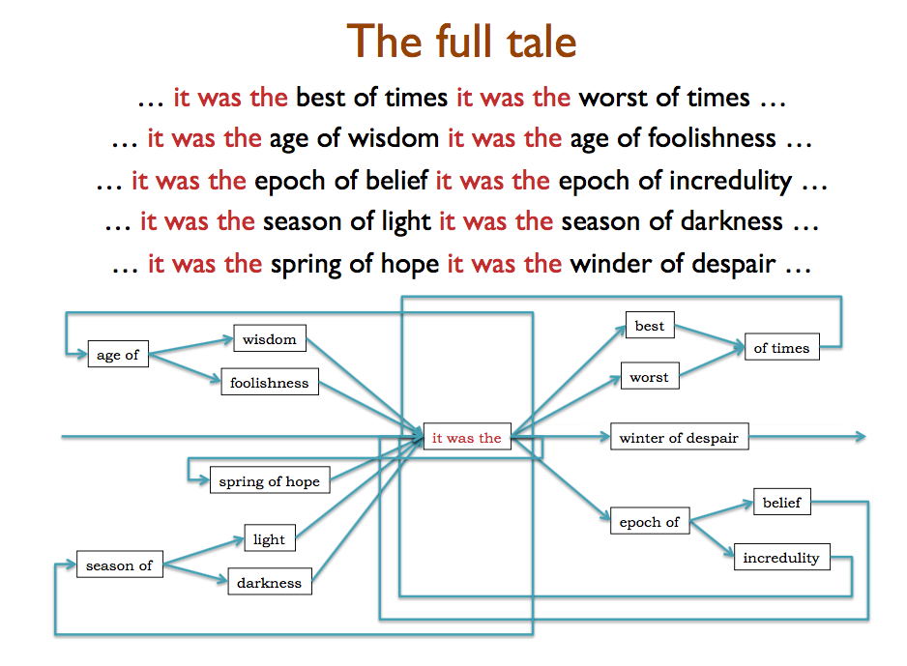
Slides courtesy of/after Mike Schatz, Cold Spring Harbor Laboratory http://schatzlab.cshl.edu/teaching/2014/

Slide 20

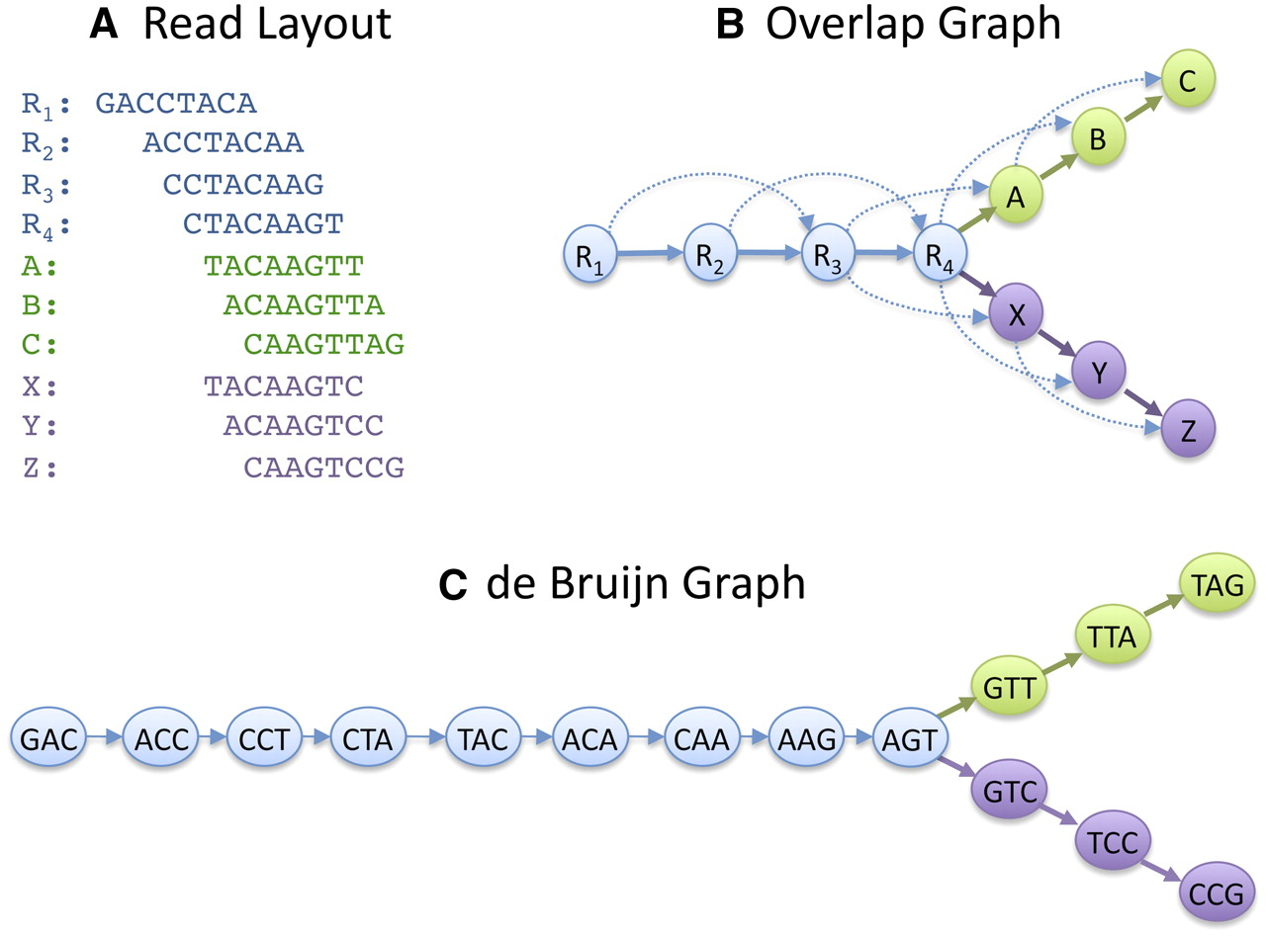
de Bruijn graphs
Developed outside of DNA-related work
Best solution for very short reads ≤100 nt
Read
GACCTACA
GAC
ACC
CCT
CTA
TAC
ACA
de Bruijn graph
K-mers (K=3)
K-1 bases overlap

Slide 21
Graphs
GACCTACA
ACCTACAA
CCTACAAG
Region 1
CTACAAGT
TACAAGTT
ACAAGTTA
CAAGTTAG
GACCTACA
ACCTACAA
CCTACAAG
Region 2
CTACAAGT
TACAAGTC
ACAAGTCC
CAAGTCCG
Schatz M C et al. Genome Res. 2010;20:1165-1173

Slide 22
How I teach assembly
0) Target audience
MSc and PhD students in
biology and informatics

Slide 23
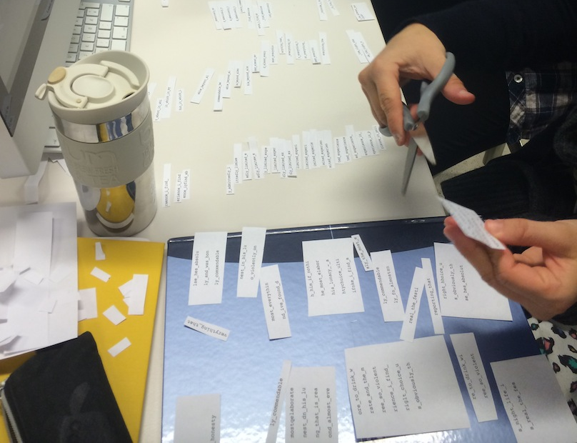
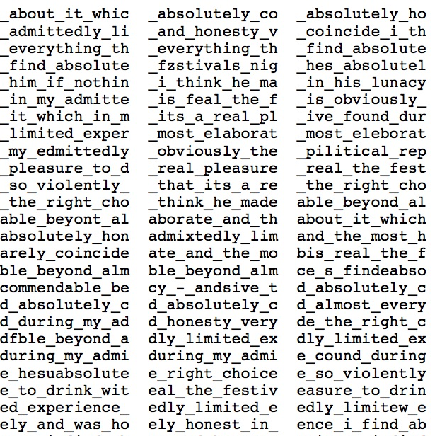
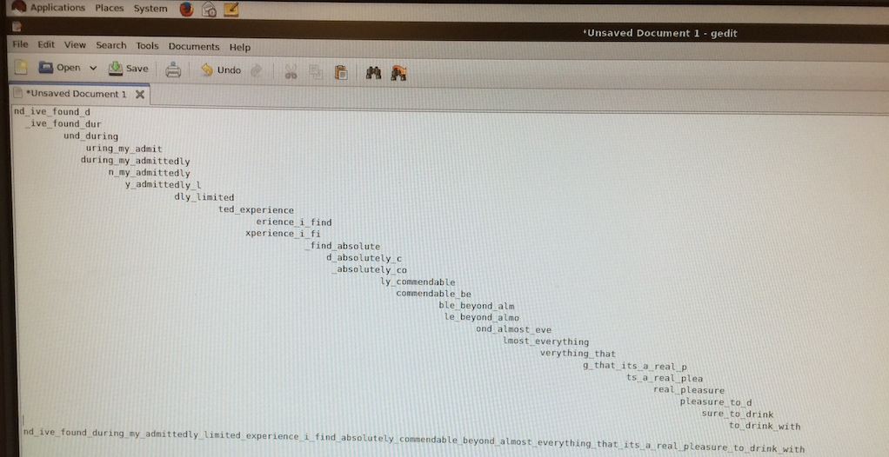
How I teach assembly
1) Assembly exercise
ivory.idyll.org/blog/the-assembly-exercise.html

Slide 24
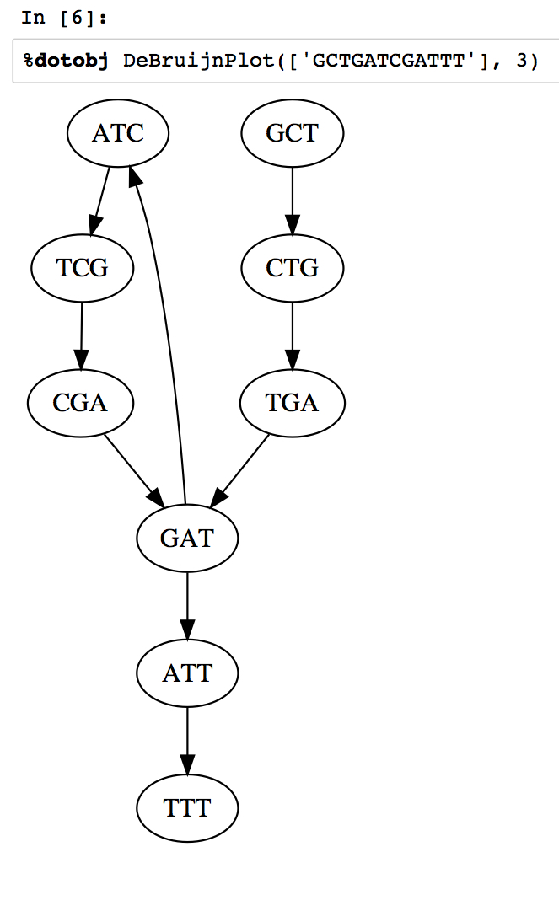
How I teach assembly
2) Exploring de bruijn graphs
with the Jupyter notebook
Modified from
http://nbviewer.ipython.org/github/BenLangmead/comp-genomics-class/blob/master/notebooks/CG_deBruijn.ipynb

Slide 25
How I teach assembly
3) Collaborative exploration of parameter space
We will do this today!

Slide 26
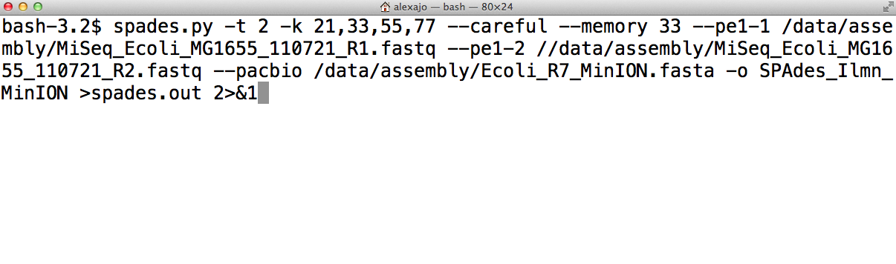
How I teach assembly
4) Try different programs, compare

Slide 27
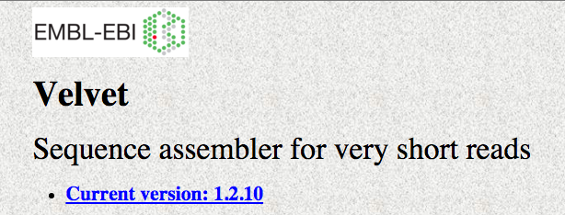
Exercise
Collaborative exploration of parameter space
Organism
Data
Software
Escherichia coli bacterium
4.6 million characters
Illumina
150 bp paired reads
50 x oversampling
Velvet
De Bruijn graph assembler
https://en.wikipedia.org/wiki/Velvet_assembler

Slide 28
kmers
Need to be odd
Cannot be longer than the reads
You will each pick a kmer size

Slide 29
Metrics
ACGCGATTCAGGTTACCA
GCGATTCAGGTTACCACG
GATTCAGGTTACCACGCG
TTCAGGTTACCACGCGTA
CAGGTTACCACGCGTACG
GGTTACCACGCGTACGCG
TTACCACGCGTACGCGAT
ACCACGCGTACGCGATTA
CACGCGTACGCGATTACA
CGCGTACGCGATTACACA
CGTACGCGATTACACAGATT
TACGCGATTACACAGATTAG
ACGCGATTCAGGTTACCACGCGTACGCGATTACACAGATTAG
→ “contig”

Slide 30
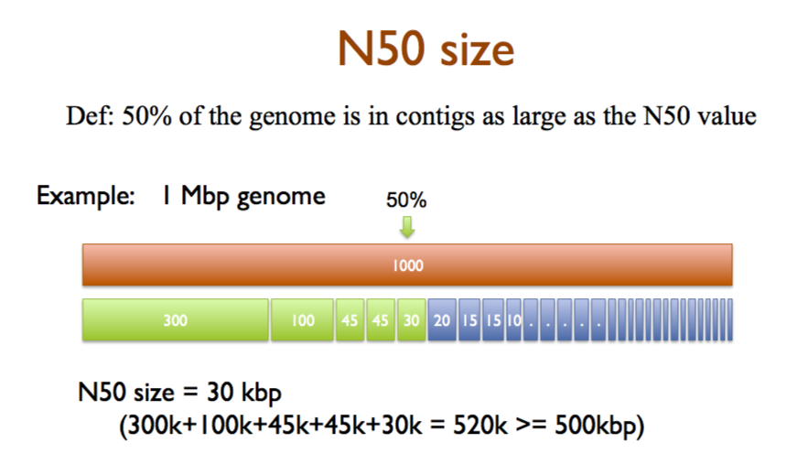
Metrics
Size of contig such that 50% of total bases are in contigs of this length or more
Slides courtesy of/after Mike Schatz, Cold Spring Harbor Laboratory http://schatzlab.cshl.edu/teaching/2014/

Slide 31
Next steps
Install the velvet assembly program
Download some reads
(150 bp paired reads)
Pick a kmer
Run velvet assembly using that kmer
Compare results

Slide 32
Important!
You need an m4.xlarge instance
at amazon or equivalent
Compile velvet allowing for kmers up to 127:
make 'MAXKMERLENGTH=127'

Slide 33
Sticky notes
Green sticky
use the spreadsheet at
bit.ly/SWDCretreatVelvet
Red sticky
submit an issue at
https://github.com/lexnederbragt/swc-instructor-retreat-2015-3PM-UTC
Green sticky
use the spreadsheet at
bit.ly/SWDCretreatVelvet
Red sticky
submit an issue at
https://github.com/lexnederbragt/swc-instructor-retreat-2015-3PM-UTC

Slide 34
Next steps
Install the velvet assembly program
Download some reads
(150 bp paired reads)
Pick a kmer
Run velvet assembly using that kmer
Compare results
https://github.com/lexnederbragt/swc-instructor-retreat-2015-3PM-UTC
File Assembly_using_velvet.md

Slide 35
Conclusion

Slide 36
Next example
A very simple way of asking
multiple choice questions

Slide 37
Why did the contig N50 distribution show a peak?
There is an optimal kmer size for resolving all repeats
Higher and lower kmers result in fewer overlaps between the reads
At higher kmers, more repeats are resolved, but overlaps between the reads are lost
At higher kmers, more repeats are resolved, but errors in the reads fragment the assembly more
bit.ly/SWDCretreatMCQ

Slide 38
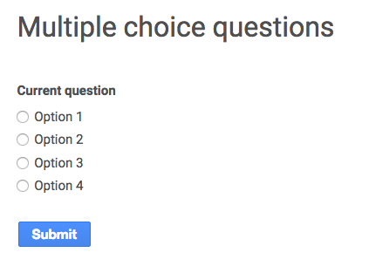
Multiple choice questions via Google form
Set up form with four answers
Show the multiple choice question with answers
each students forms her/his opinion
students discuss the question in pairs
each student votes for her/himself
show the tally of the votes
student pairs discuss the tally and consider whether they want to change their opinion
students vote again and the tally is shown again
discuss the answers

Slide 39
Important
Terminate your instance!

Slide 40
Taking MCQ offline
Sticky notes
Green sticky
Red sticky

Slide 41
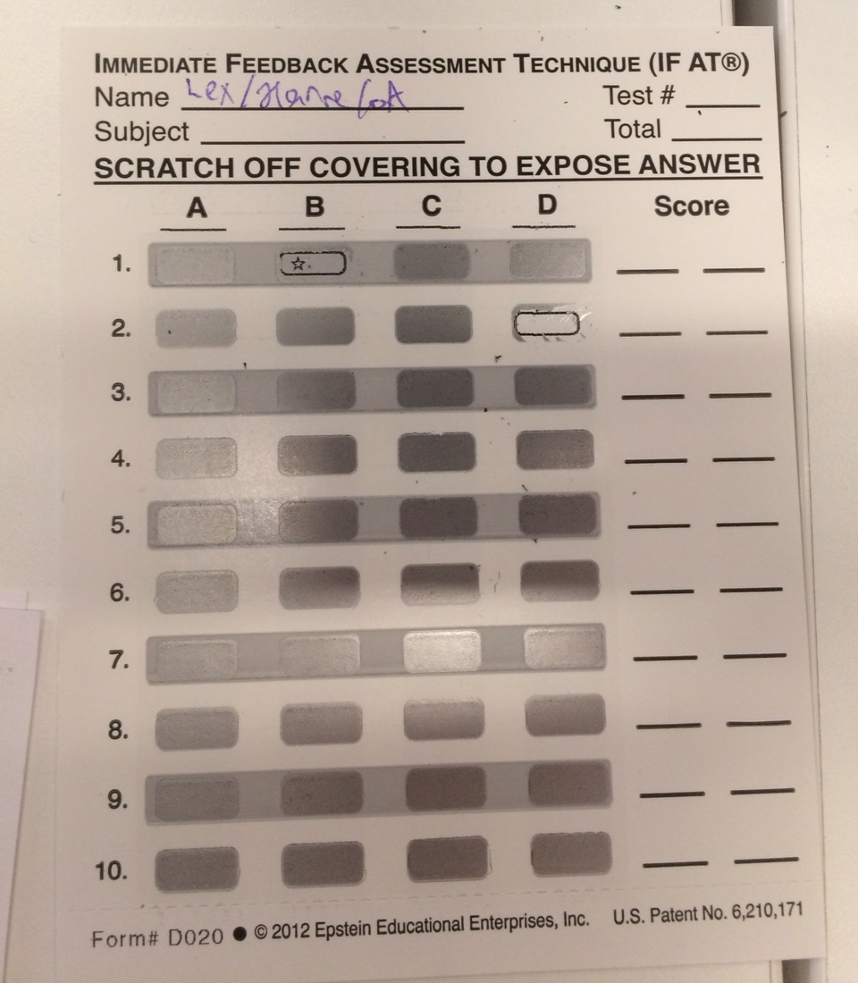
Taking MCQ offline

Slide 42
Some further resources
PeerWise: peerwise.cs.auckland.ac.nz
have students generate multiple choice questions
MentiMeter: mentimeter.com
polling/multiple choice questions etc
Socrative: socrative.com
polling/multiple choice questions etc
Directpoll: directpoll.com
polling/multiple choice questions etc
Responseware: responseware.turningtechnologies.com
polling/multiple choice questions etc
Padlet: padlet.com
a wall to collect responses on

Slide 43
Some further resources
Greg Wilson’s EuroSciPy 2015 presentation/workshop
Evidence Based Teaching What We Know and How to Use
https://www.youtube.com/watch?v=kmVKGxPlTvc
From my blog
https://flxlexblog.wordpress.com/2015/08/31/active-learning-strategies-for-bioinformatics-teaching-2/
https://flxlexblog.wordpress.com/2015/09/23/notes-from-the-febs-iubmb-workshop-on-education-in-molecular-life-sciences

